Slide 1
Week-03 Modeling for web applications
Course Instructors:
Haris Ahmed
SIR SYED UNIVERSITY OF ENGINEERING & TECHNOLOGY

Slide 2
agenda
Introduction
Software Application Modeling vs Web Application Modeling
Model Driven Development
Reference Scenario
Content Modeling
Hypertext Modeling
Presentation Modeling
Summary

Slide 3
INTRODUCTION
Why Create Models?
Define an abstract view of a real-world entity
– Finding & discovering objects/concepts in a domain
– Assigning responsibilities to objects
Tool of thought
– Reduce complexity
– Document design decisions
Means of communication

Slide 4
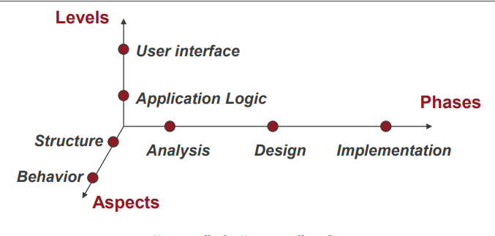
Software Application Modeling
Levels – the “how” & “what” of an application
Aspects – objects, attributes, and relationships; function & processes
Phases – Development cycle

Slide 5
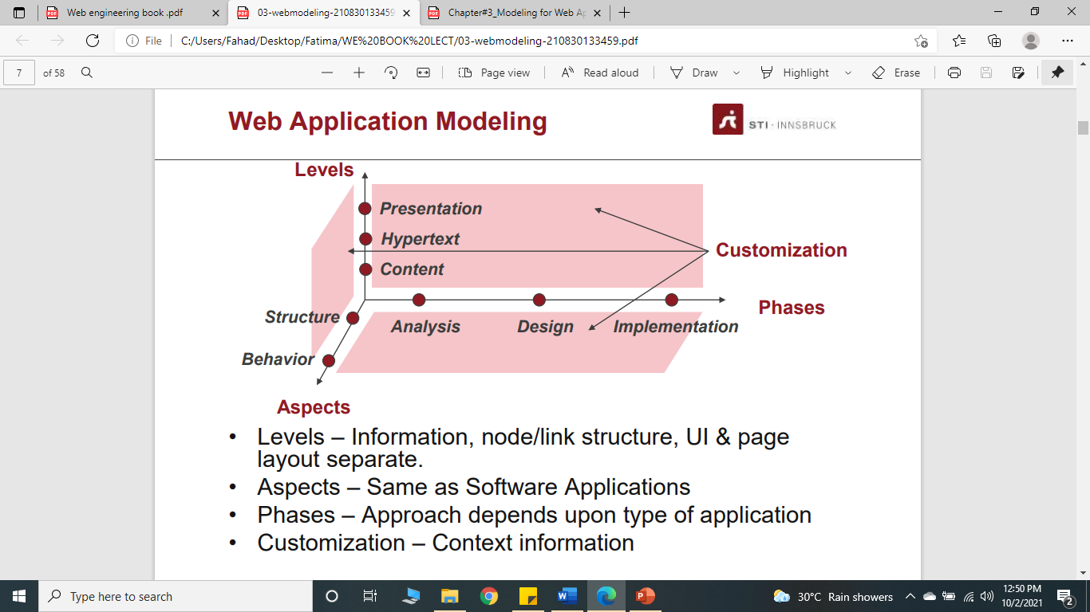
Web Application Modeling
Levels – Information, node/link structure, UI & page layout separate.
Aspects – Same as Software Applications
Phases – Approach depends upon type of application
Customization – Context information
Notes:
Levels:
The three levels are content, i.e., the information and application logics underneath the Web application, hypertext, i.e., the structuring of the content into nodes and links between these nodes, and the presentation, i.e., the user interface or page layout. Most methods which are used to model Web applications follow this separation into three levels. A clear separation of these three levels allows reuse and helps to reduce complexity.
Aspects:
Following the object-oriented principles, structure and behavior are modeled at each of the three levels, i.e. at content, hypertext and presentation. The relevance of the structure and behavior models depends on the type of Web application to be implemented.
Customization:
Customization considers the context, e.g., users’ preferences, device characteristics, or bandwidth restrictions, and allows to adapt the Web application accordingly. It influences all three Web modeling dimensions of content, hypertext, and presentation with respect to structure and behavior and should be taken into account in all phases of the development process.

Slide 6
Web Modeling
Web applications have 3 major building blocks:
Content
-Document-centric
-Generating, updating, integrating, quality assurance
Hypertext (Navigation)
-Non-linear nature of hypertextual documents
-Hypertext models: links(absolute and Relative), nodes (URL), anchors
-Disorientation
Presentation
-User Interface
-Self-explanatory
-Aesthetics

Slide 7
Web Modeling
Modeling static & dynamic aspects of content, hypertext, and presentation
We focus on object-oriented analysis & design
– Analysis: Finding & discovering classes of objects/ concepts in a domain
– Design: Defining software objects & how they interact to fulfill requirements.

Slide 8
What is Model Driven Architecture?
Key concepts
– abstraction from implementation detail
– systematic transformations
Main idea:
– Addresses the complete system development life cycle
– Separate specification from implementation
– Specify a system that is independent of a platform
– Transform a platform-independent (PIM) system specification into a specific platform (PSM)
– Code generation

Slide 9
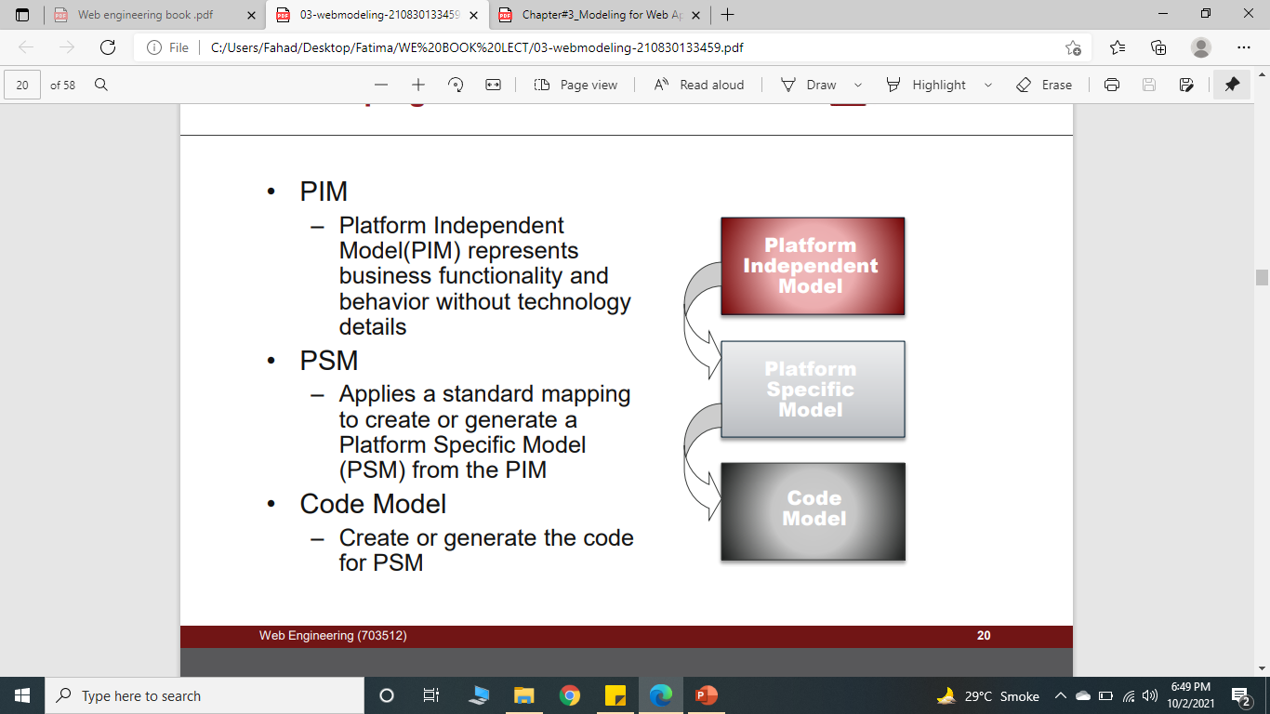
Developing in the MDA
PIM
– Platform Independent Model(PIM) represents business functionality and behavior without technology details
PSM
– Applies a standard mapping to create or generate a Platform Specific Model (PSM) from the PIM
Code Model
– Create or generate the code for PSM

Slide 10
REFERENCE SCENARIO
A simple walkthrough case study

Slide 11
The Conference Review System
This case study was presented at IWWOST to compare different Web application modeling methods
The purpose of the system is to support the process of submission, evaluation and selection of papers for a conference.

Slide 12
Actors I
PC Chair
– creating the conference
– determining the conference topics (or tracks) and subjects
– establishing the Program Committee
– defining the final list of accepted and rejected papers
– defining the conference deadlines: submission, review, and notification.
PC Member
– evaluating a set of papers assigned to him
– indicating another person as a reviewer of a paper
– advising the PC Chair for the final list of accepted papers

Slide 13
Actors II
Reviewer
– responsible for reviewing a paper
Author
– submitting a paper for acceptance at the conference
– PC Members and Reviewers may also be Authors; they must have different Ids for each role

Slide 14
Function I: Paper Submission
Any registered author may submit a paper
– The author must register: the title, the abstract, the conference track, and a set of subjects chosen from a list previously determined by the PC Chair, if there is one
– The system, after checking the authors’ registrations, assigns a paper ID to the new paper, and allows the user to submit it by uploading a file
– At any moment, an author is allowed to check the data about his submitted papers. Until the submission deadline, the author is also allowed to substitute the uploaded file by a new one, or to change any of the informed data about the paper

Slide 15
Function II: Assignment of Papers to PC Members
The PC Chair may indicate potential conflicts of interest between PC Members and submitted papers
Once the submission deadline has been reached
– PC Members may indicate their interest and also conflicts of interest with some papers
– In case of conflict of interest, the PC Member will not see any information about the paper
– The PC Chair assigns papers to PC Members for reviewing, an email message with the list of papers, and a URL to a page where he can access these papers is sent

Slide 16
Function III: Entering a Review
A PC Member, or a Reviewer, may enter a review for a paper assigned to him
The review is entered by accessing a form containing all the evaluation items
A PC Member may see other reviews (entered by others) for any of the papers he is reviewing, but only after he has entered his own review
The PC Chair has full access to all papers and all reviews

Slide 17
Function IV: Choosing Accepted and Rejected Papers
Once the review deadline has been reached, the review process is closed
The PC Chair, taking into account the recommendations of the PC Members and reviewers, chooses the papers that will be accepted and rejected
Once the process is marked as finalized by the PC Chair, the system issues a notification message to paper authors, which includes the appropriate parts of the reviews submitted by the PC Members and reviewers

Slide 18
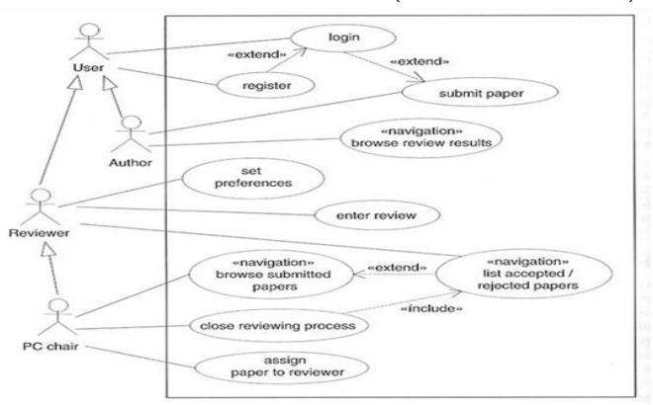
Basic use case model of the reviewing system.
Notes:
The overall functionality of a Web application is modeled as a set of use cases, which describe the Web application requirements from the actors’ (people and other systems) perspectives.
you can use an extend relationship to specify that one use case (extension) extends the behavior of another use case (base)
an include relationship is a relationship in which one use case (the base use case) includes the functionality of another use case (the inclusion use case).

Slide 19
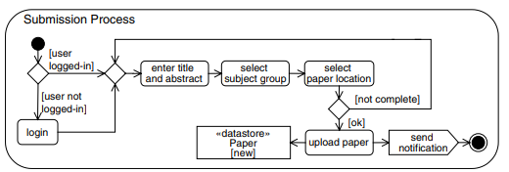
Activity diagram of the submission process.

Slide 20
How to model the data underlying a Web application CONTENT MODELING
Purpose: To model the information requirements of a Web application
– Diagramming the structural (i.e., information objects) & behavioral aspects of the information.
– NOT concerned with navigation.
Primary Models
– Class diagrams – enough for static applications.
– State machine diagrams – captures dynamic aspects
Notes:
Content modeling produces a model that comprises both the structural aspects of the content, e.g., in the form of a class diagram, and, depending on the type of Web application, the behavioral aspects, e.g., in the form of state and interaction diagrams.

Slide 21
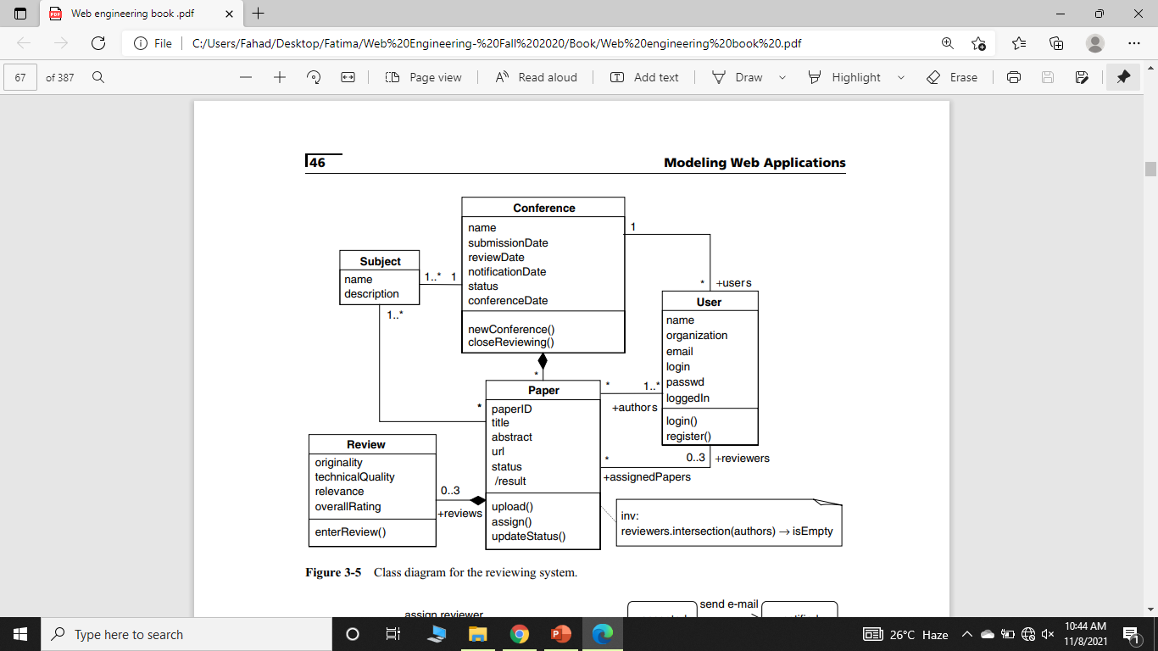
Content Structure Model
Notes:
Class diagram for the reviewing system.
Aggregation: [void] implies that a relationship where child can exist independently of the parent.
Composition:[full] implies that a relationship where the child cannot exist independent of the parent.

Slide 22
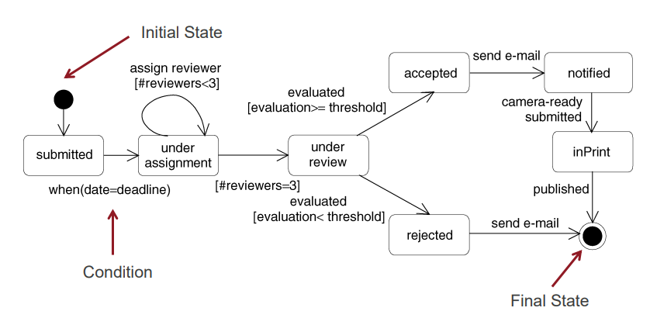
Content Behavior Model
Notes:
State machine diagram for the states of a paper in the reviewing system.
Figure shows a state machine diagram used to model the various states of a paper in the reviewing system. It shows that a submitted paper will be assigned to three reviewers for review after the submission deadline has expired. If a pre-set threshold value is reached, the paper is accepted; otherwise, it is rejected. In both cases the authors are notified via e-mail about the outcome of the review. Finally, an accepted paper will be printed once the final version has been submitted.

Slide 23
How to model the hypertext of a Web application HYPERTEXT MODELING
Purpose: To model the navigation paths available to users
Artifacts
– Hypertext Structure Model – navigating among classes
– Access Model – UML-compliant site map
Focuses on the structure of the hypertext & access elements
Use “<<navigation class>>” annotation to distinguish from content classes
Based on content models
Notes:
Hypertext modeling generates a two-fold result: First, it produces the hypertext structure model, also known as navigation structure model which defines the structure of the hypertext, i.e., which classes of the content model can be visited by navigation. Second, it refines the hypertext structure model by access elements in the form of an access model.

Slide 24
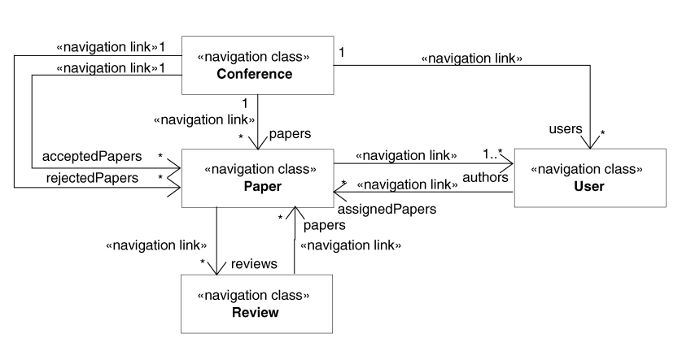
Hypertext / Navigation Structure Model
Notes:
Figure shows the hypertext structure model for the PC chair’s view. A PC chair can view all submitted papers. In addition, the PC chair can access the list of accepted or rejected papers, and the reviewer profiles.

Slide 25
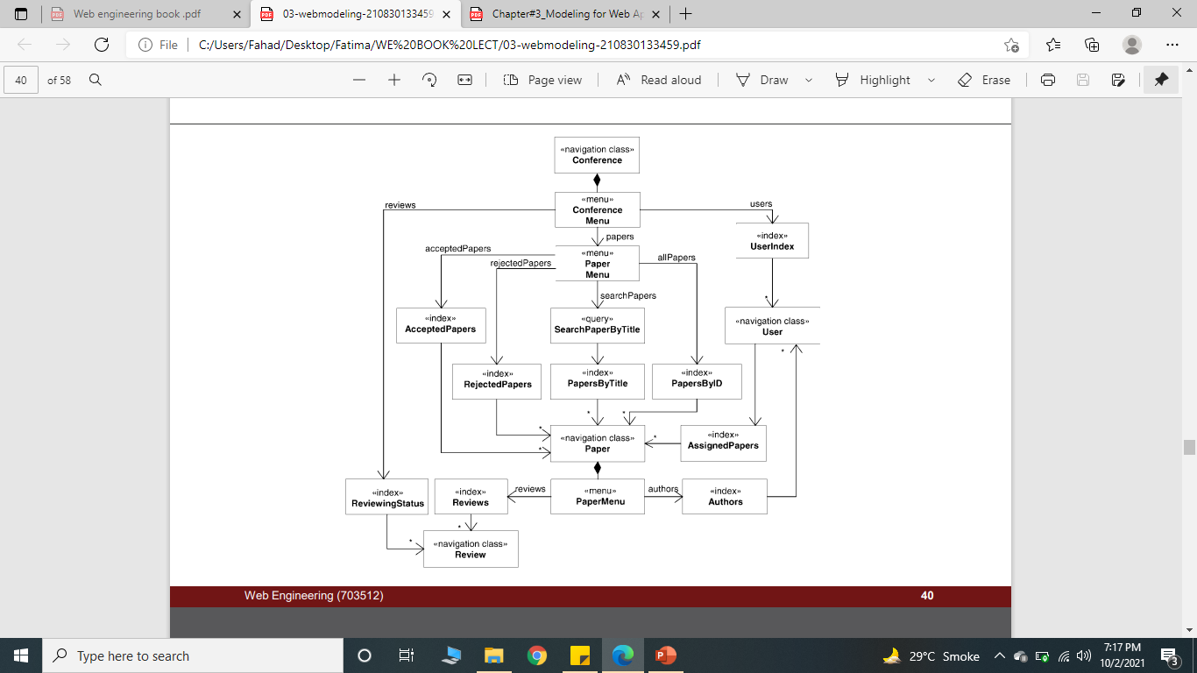
Navigation Access Model
Notes:
Figure shows a simplified access model of the PC chair’s view specified in the hypertext structure model in our reviewing system.

Slide 26
How to model the look & feel of a Web application PRESENTATION MODELING
Purpose: To model the look & feel of the Web application at the page level.
The design should aim for simplicity and self-explanation.
Describes presentation structure:
– Composition & design of each page
– Identify recurring elements (headers/footers)
Describes presentation behavior:
– Elements => Events

Slide 27
Levels of Presentation Models
Presentation Page – “root” element; equivalent to a page container.
Presentation Unit
– A fragment of the page logically defined by grouping related elements.
– Represents a hypertext model node
Presentation Element
– A unit’s (node’s) informational components
– Text, images, buttons, fields

Slide 28
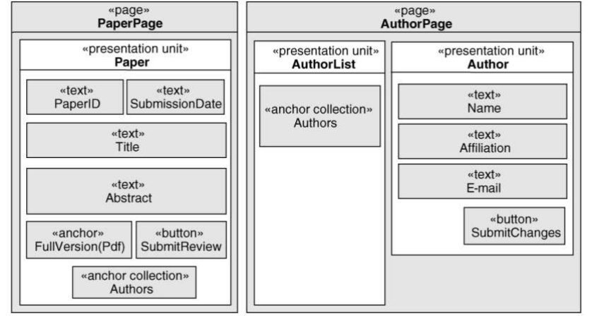
Presentation Structure Model
Notes:
Presentation pages of the reviewing system.
Model elements are described on three hierarchical levels:
A presentation page describes a page presented to the user as a visualization unit. It can be composed of different presentation units.
A presentation unit serves to group related user interface elements, representing a logical fragment of the page. It presents a node stemming from the hypertext model.
A presentation element is the basic building block of the presentation model. Presentation elements represent a node’s set of information and can include text, images, audio, etc.

Slide 29
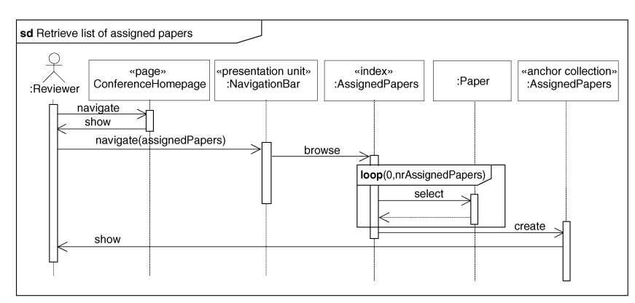
Presentation Behavior Model
Notes:
Sequence diagram for retrieving a list of assigned papers.

Slide 30
TODO TASK
Draw Sequence diagram for displaying selected papers.

Slide 31
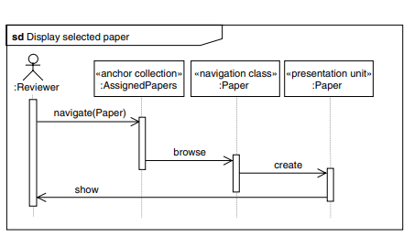
Sequence diagram for displaying selected papers.

Slide 32
summary
Modeling is fundamental
– Helps development
– Support communication
Model Driven Design and Development
– Automatic code generation of Web applications
One model for each layer
– Content
– Navigation
– Presentation

Slide 33
Bibliography
Mandatory reading
– Web Engineering Book, Chapter 3
Suggested
– UML-based Web Engineering

